Slide 1


YEAR 10
MONDAY 1st July- 12th July 2024
Notes:
1

Slide 2
Why WEX?
An opportunity to explore the “real world” - new challenges, variety of people.
Develop skills: punctuality, organisation, team-work and awareness of others.
Give you an “employability factor” and additional references – great for college or part time jobs.
Notes:
2

Slide 3
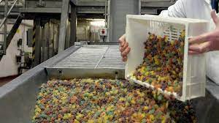
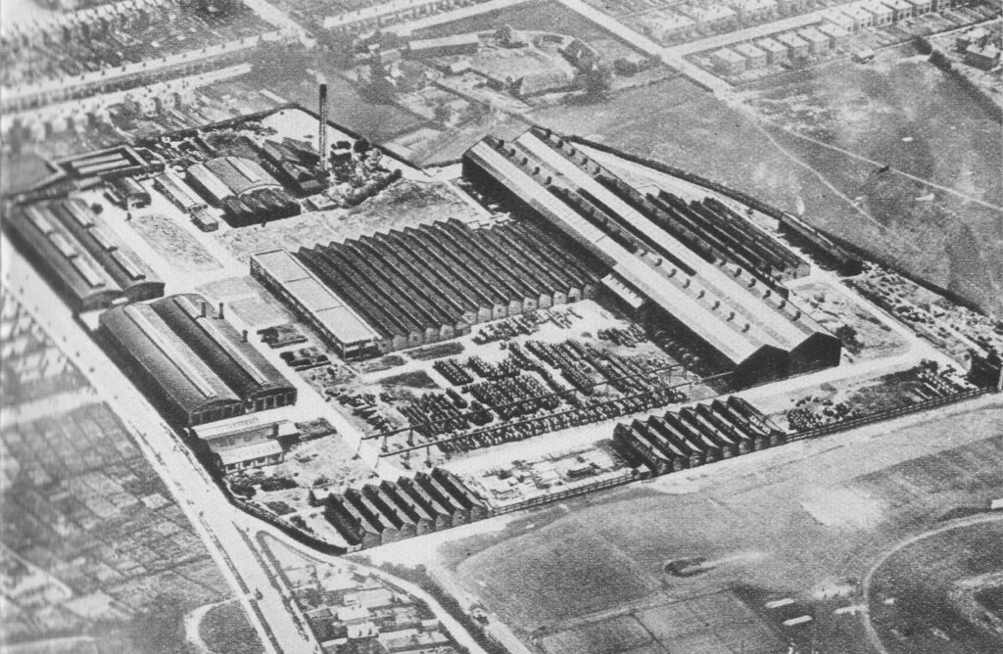

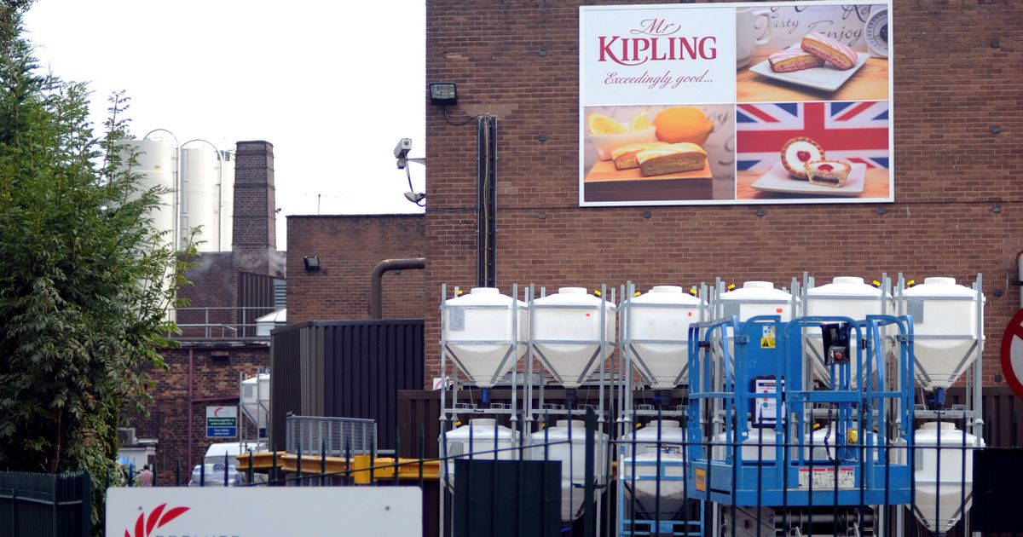


Why WEX?
Work experience has been something schools and colleges have been doing for many years…
Eastleigh, 1970’s
Notes:
3

Slide 4
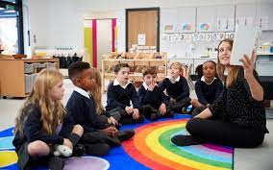
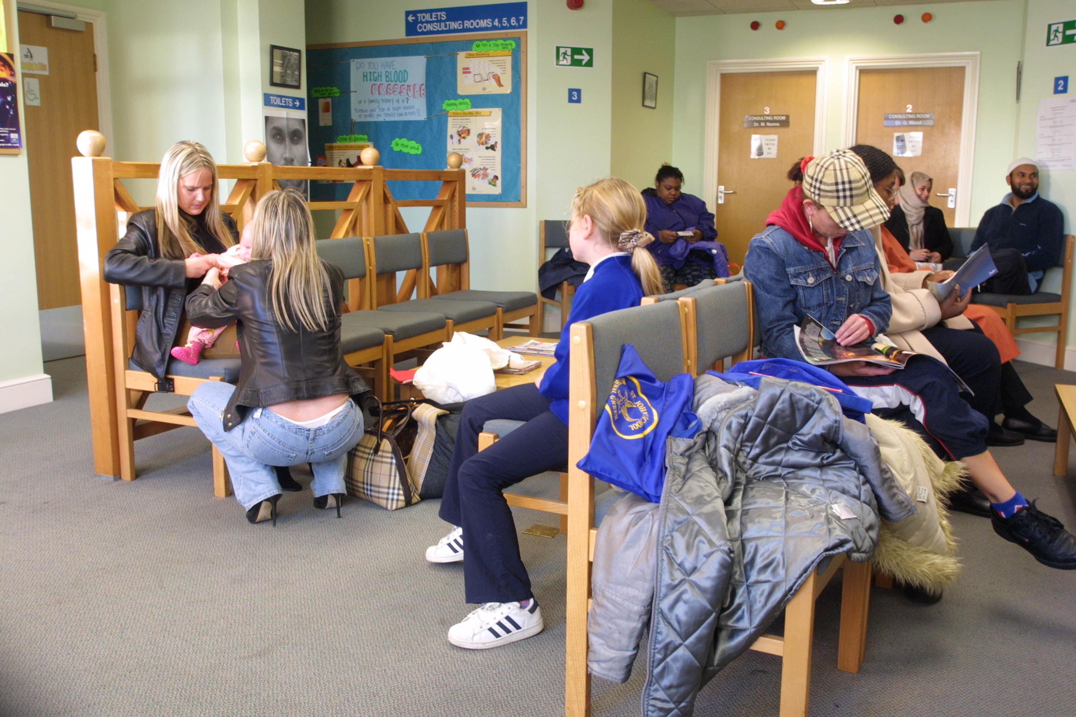
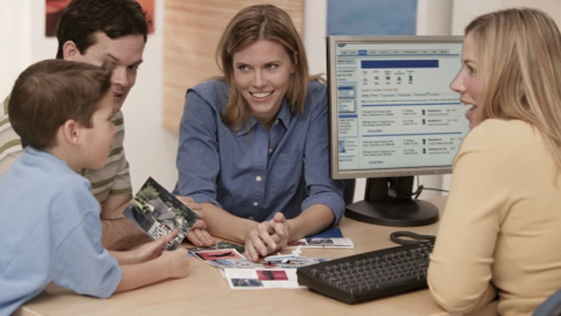
How do we do WEX?
Don’t worry if you don’t know where you want to go
Don’t panic- it doesn’t have to be your dream job!
Still be a valuable experience and very enjoyable.
Can help you decide what you do/DON’T want to do!
Notes:
4

Slide 5
Comments from our Y11
“Find it NOW, all the good placements go really fast”
“I thought I would hate mine, but I actually really liked it!”
“It is really tiring but really fun, I want to go back in the Summer when I finish”
“I wish I had sorted my placement out sooner as I really wanted to do engineering but there were no places left”
“I got a part time job because of mine”
“The 2 weeks goes really fast if you are enjoying it!
“I had the best 2 weeks, thank you for helping me”
Notes:
5

Slide 6
What next?
Collect the WEX Placement form from the Info – these are electronic, too
Make a list of possible jobs/places you would like to go to
Be ambitious but also realistic – what is around locally?
Research into all aspects of the job e.g. hairdressers don’t just cut hair!
Travel – how will you get there/back? Do you need to ensure you have support with this? Can you walk/bus/train?
Legalities – are you allowed? Age limits? H&S? PPE?
These 2 weeks are directed time – you cannot go on holiday during these 2 weeks.
Notes:
6

Slide 7
How to find a placement?
Family, friends, local businesses, connections, past WEX employers, GOOGLE:
Polite and articulate letters/emails or a friendly visit – but do remember people are busy and they are doing YOU a favour!
This is your opportunity to make these 2 weeks as worthwhile and enjoyable as you want.
You have support but We can only help if you reach out.
Notes:
7

Slide 8
Once you have an idea for a placement
Arrange to visit the company as soon as possible.
Take the ‘WEX Own Placement Form’ with you.
Employer part: this must be completed and signed by the person who has agreed to the placement.
Parent/Carers fill in and sign their part.
Return the form to the Info Centre staff as soon as possible - no later than 4th of MARCH 2024
Notes:
8

Slide 9
Comments from our employers
“Amazing, strongly encourage the students to apply for an apprenticeship next year with us”
“Very professional in her approach to work and completing jobs”
“XXXXXX has been offered a part time job”
“Would not hesitate to employ now if it were possible”
“Working better than many of the casual staff that we have XXXXXX has a bright future ahead of them. I wish him well!”
“Very quiet to start with, but now much more confident, great sense of humour and worked well with everyone, sorry to see her leave”
Notes:
9

Slide 10
WEX prep
Opportunity to research local employers for contact details – placement opportunities Make use of local area/tutors/friends/family
CV writing – later in the year.
Pay close attention to Careers lessons in AF – lots of info.
Interview Skills and Techniques - Mock Interviews (March).
Health & Safety and Expectations in the Workplace Assembly (May).
Notes:
10

Slide 11

REMEMBER…
All work experience placements will be valuable, it doesn’t necessarily have to be your dream job or chosen career path.
Notes:
11

Slide 12
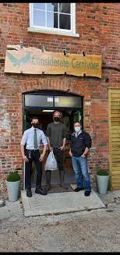
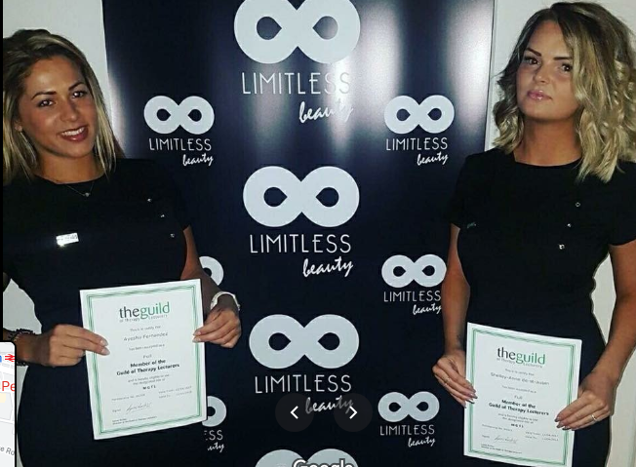
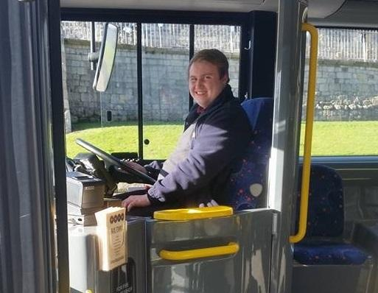
Harry
Ayesha
Liam
Did his work experience at a bus company. Was taken on as an apprentice and became one of the countries youngest bus drivers.
Was placed last-minute at a butchers shop. Excelled and was offered a part time job. Now has his own thriving business.
Did work experience in a beauty salon. Now has 2 salons and her own training academy. All by the time she was 30.
Notes:
12

Slide 13
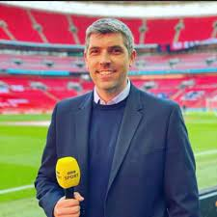
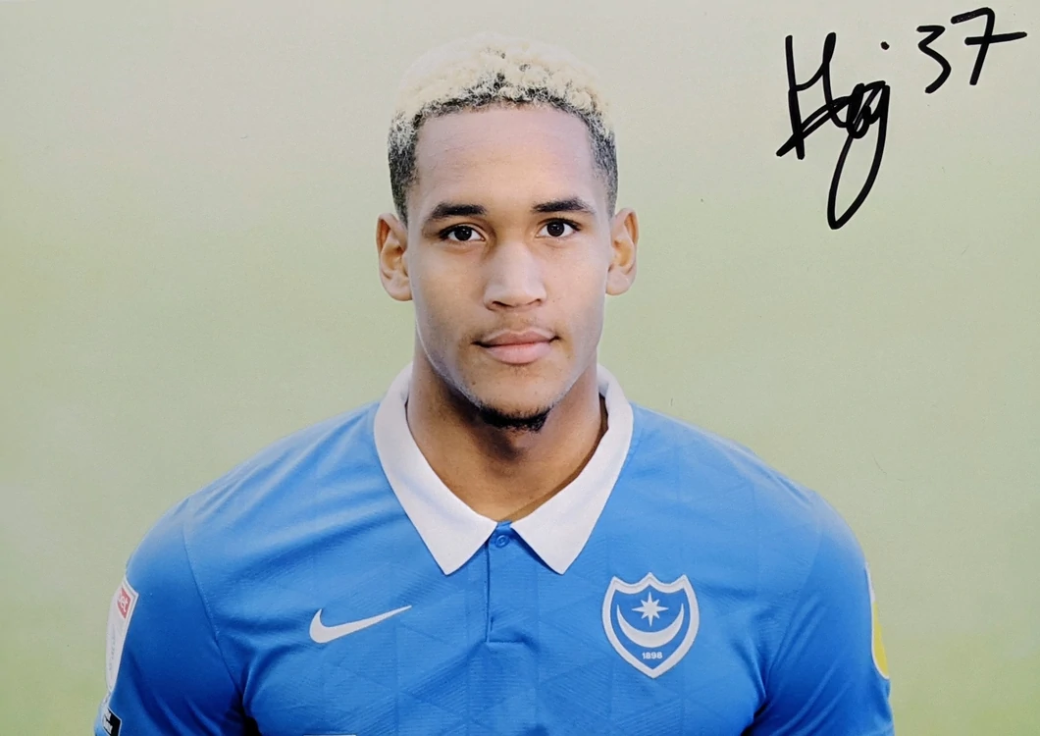
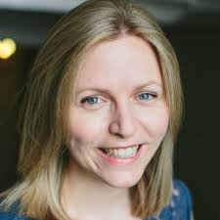
Katie
Haji
Lewis
Did work experience in PR. Decided she liked behind the scenes more. Now is a successful app developer and has her own ethical wellbeing business on the side.
Went to primary and secondary school in Portsmouth (I was his teacher). Always wanted to be a footballer. Did work experience with a PE teacher. Now plays for Portsmouth and England (currently on loan at Weymouth).
Did his WEX in a shop. Went to Highbury College and studied journalism. Used to volunteer at the TV studios. Now has the sports editor on BBC South Today.
Notes:
13

Slide 14


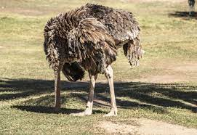
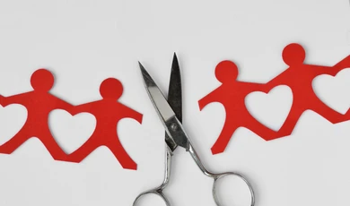
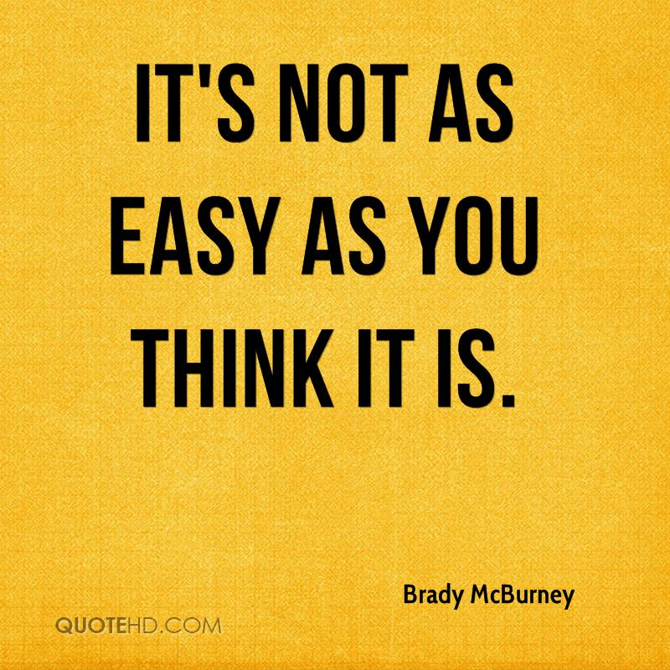
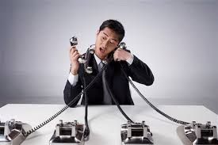

Most importantly…

Slide 15
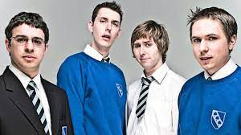
What next?
https://youtu.be/DQcNebRkDSs
Notes:
15

