Slide 1
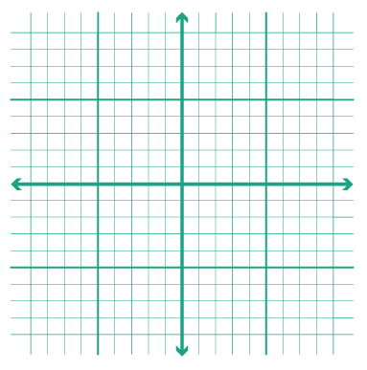

KS4 Curriculum Map Foundation Tier
Area, Perimeter &
Right Angled Triangles
February Mocks
E
16
15
M
Exams
Indices &
Standard Form
Multiples and Factors
Solving Equations
R
12
13
14
Algebraic
Manipulation
Revision
M
Revision
Probability
R
11
10
November Mocks
Averages
∑
Coordinates & Graphs
Work Experience
9
8
E
WEX
Y11
Year 10 Exams
Compound Measures
7
Angles &
Bearings
Perimeter
and Area
6
5
4
Transformations
Volume &
Surface Area
End KS3
Percentages
3
KS2
S
KS3
S
F
Y10
1
2
SATs
Start KS3
Rounding and
Error Intervals
Ratio and
Proportion
ALNS Mathematics Department

