Slide 1

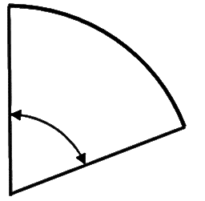
KS4 Curriculum Map Higher Tier
Revision
Real Life Graphs &
Rates of Change
February Mocks
Advanced Trigonometry
E
R
19
18
17
M
R
16
Exams
Algebraic Proof
Vectors
Revision
Bounds and
Compound Measures
Simultaneous
Equations
November Mocks
Functions & Iteration
15
10
11
12
R
M
13
14
Graphs of Circles
Revision
Histograms, Cumulative
Frequency & Box Plots
Transforming Graphs
Work Experience
Revision
Revision
Probability
Y11
WEX
M
R
E
R
11
10
Year 10 Exams
Statistics Exam
Probability
Distributions
Sampling
Interpreting Tables
Averages
Scatter Graphs
3
4
5
6
7
8
9
2
Collecting Data
Interpreting Charts
Standard Deviation
Spearman’s Rank
Conditional
Probability
Similarity and
Congruence
1
Stats
9
8
7
6
5
Types of Data
Volume and
Surface Area
Transformations
Circle Theorems
End KS3
Surds and Indices
Solve Quadratics
KS2
S
KS3
S
F
Y10
1
2
3
4
SATs
Start KS3
Graphing Inequalities
Arcs and
Sectors
ALNS Mathematics Department

